Slide 1


An S Story
Yutian Qin, Albert Han, Nana Zhang
11.18.2020

Slide 2

Content
INTRODUCTION
TECHNIQUES
INSPIRATION
DISCUSSION
1
2
3
4
A brief introduction of the whole project.
Main techniques used in this projects.
The references of songs and the story.
Places of improvements and Q & A

Slide 3

01
INTRODUCTION

Slide 4

INTRODUCTION
Part I Intro
Part II Melody
Part III 4-bit Sound
Part IV
Continued Melody
Part V Ending
Subway Sound
=U++
Fourier Transform
+
French Text
Granular Synthesis
+
Intentional Aliasing
+
Heartbeat Sound
Do You Hear the People in 4 bits
Continuing changed Melody
Heartbeat
+
Chords
Midi
+
Melody from The Prophet’s Song
+
Variable Transformation and Combination

Slide 5
02
TECHNIQUES

Slide 6
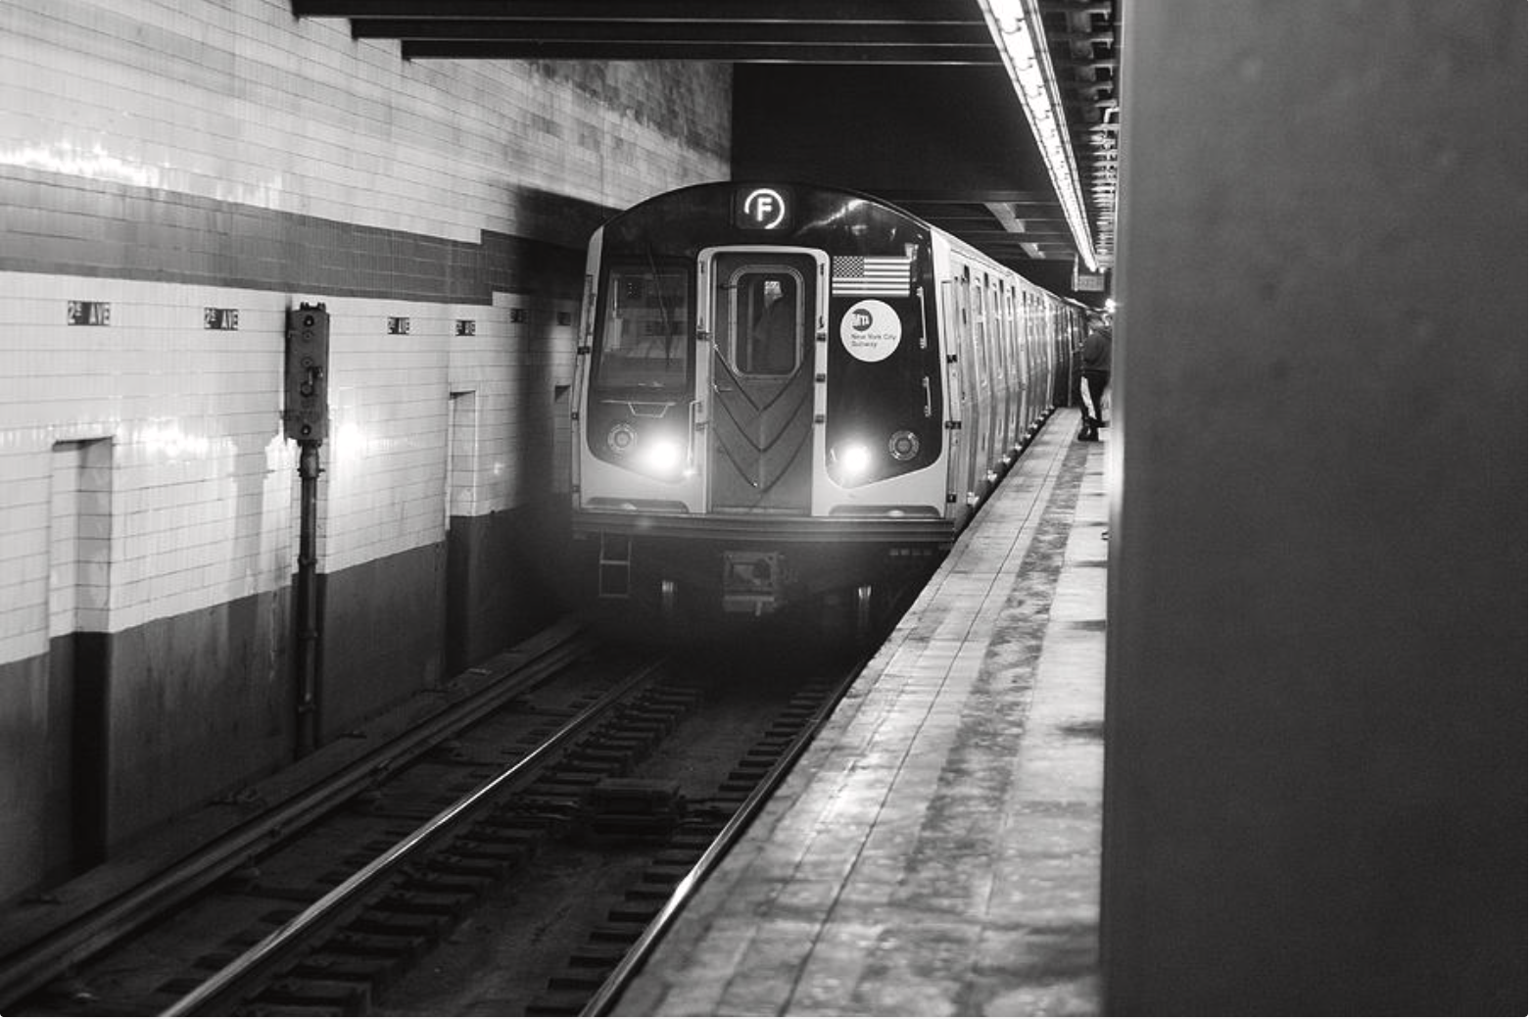
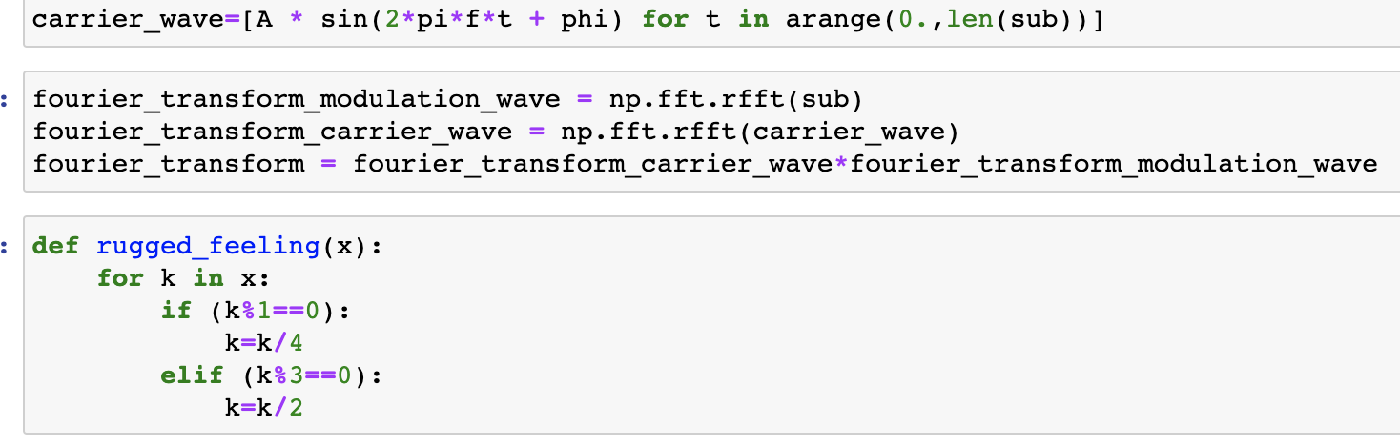
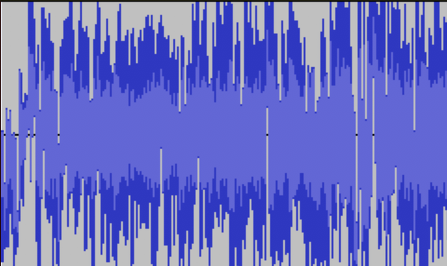
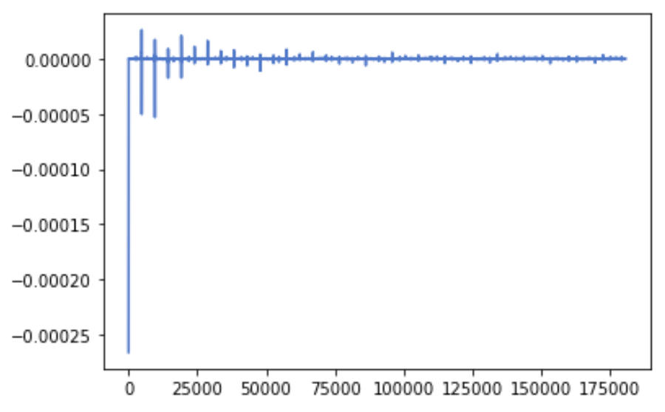
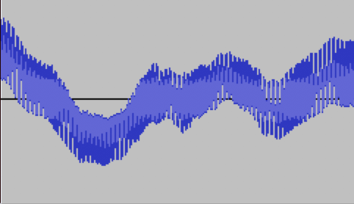
Subway Sound
Original Sound
After Convolving
FFT
Convolve
IFFT

Slide 7
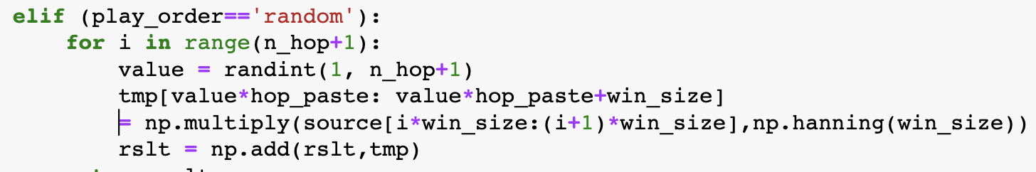
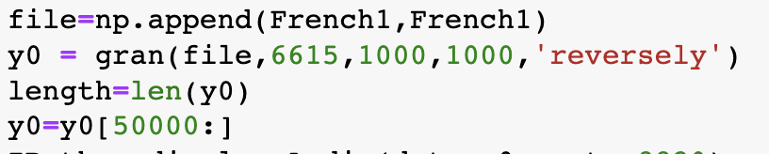
Granular Synthesis
French Text Read by Google Translate
After Synthesis

Slide 8

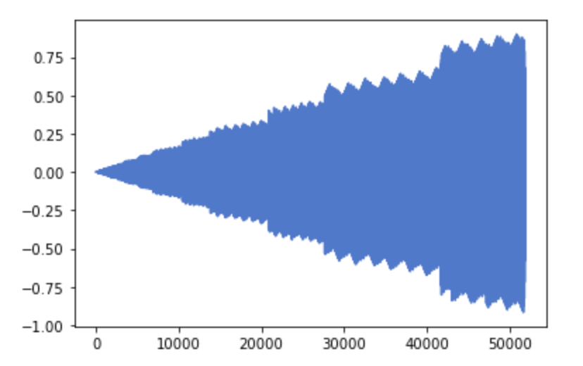
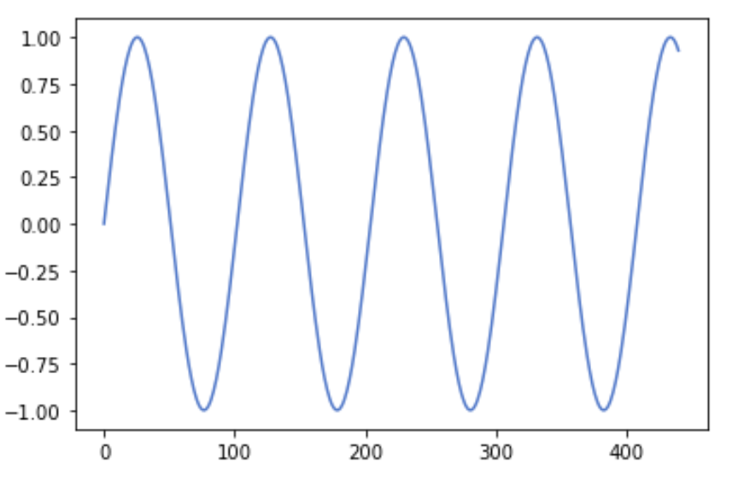
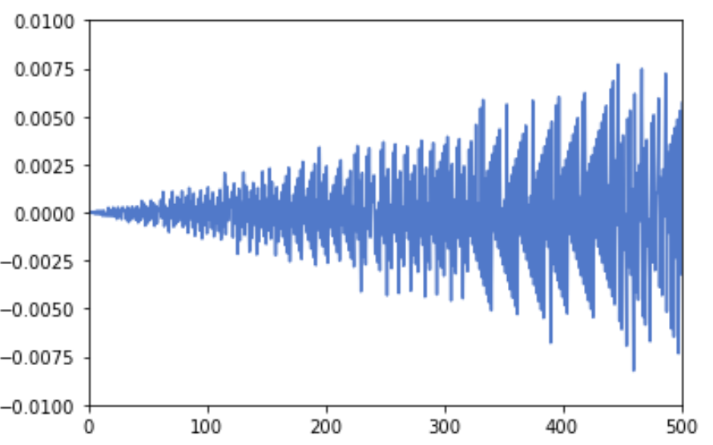
Intentional Aliasing
y = sin ( 2 * pi * f * t ) for t in arange ( 0. , t , 1./ sr )
f = 432;
sr = 864;

Slide 9
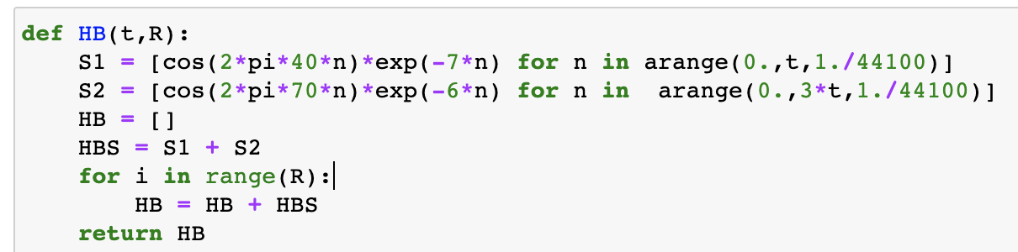

Heartbeat Sound
A simple AM Synthesis
S1 + S2 ( S3 + S4) = lub-dub
S1 - F: 40 ~ 60 Hz
S2 - F: 60 ~ 100 Hz
Reference: https://en.wikipedia.org/wiki/Heart_sounds

Slide 10
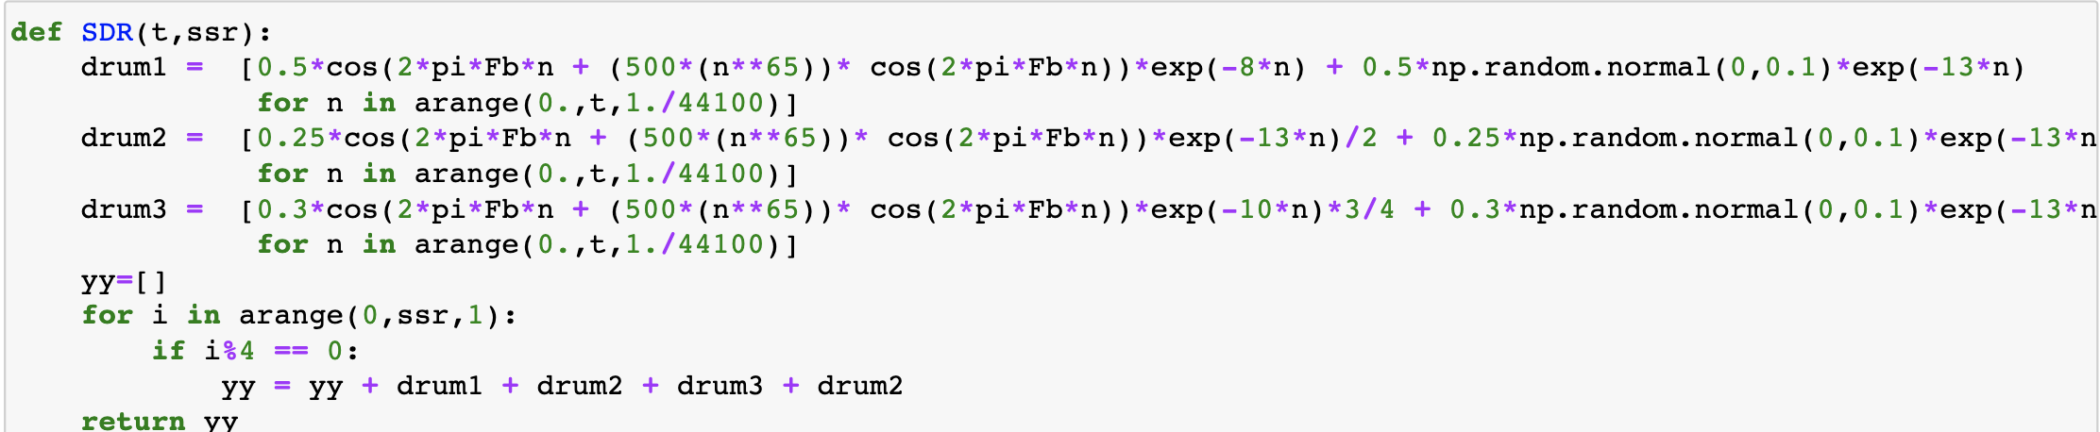
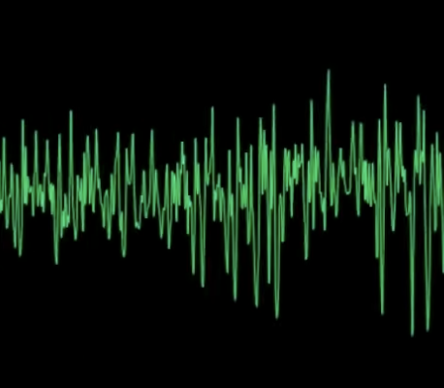
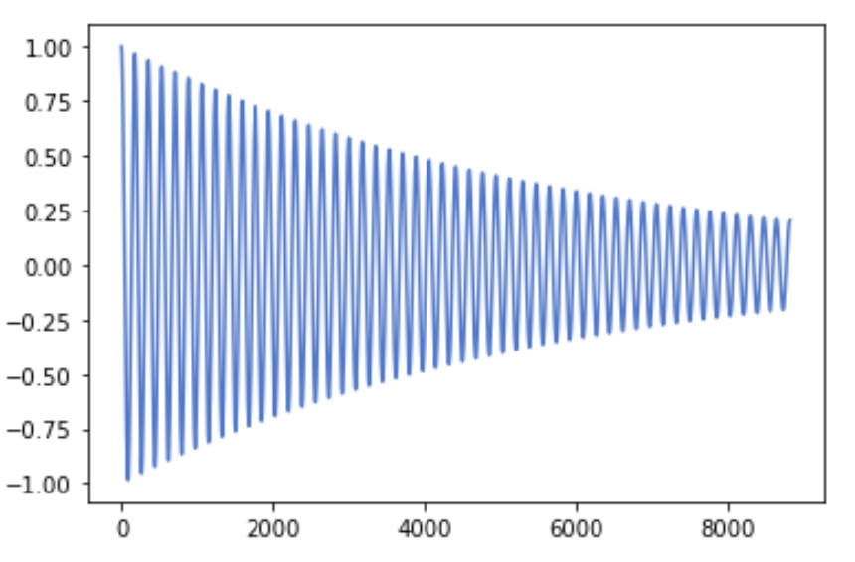
Snare Drum
White Noise
Sine Wave ( FM+AM ) = Snare Drum!
+
Reference: https://www.youtube.com/watch?v=W_UyQqiocCw&t=687s

Slide 11

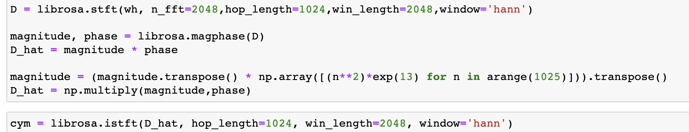
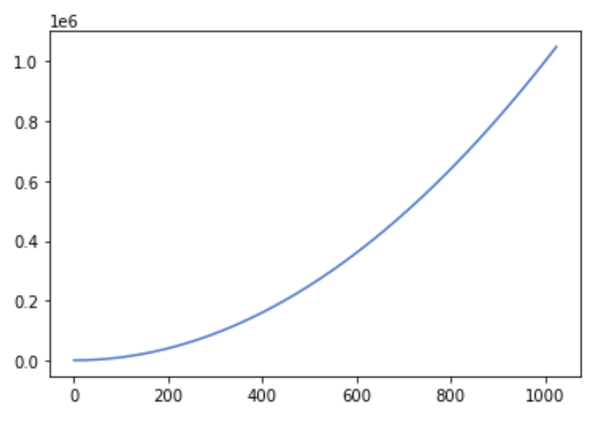

Cymbales
White Noise * Low- Pass Filter * Short time = Cymbales!
Reference: https://www.youtube.com/watch?v=W_UyQqiocCw&t=687s

Slide 12

Part II & VI
Pretty Midi
A New Canon
Adding new rows of [0,0,0,0] at the beginning and end of the original note matrix.
Bitwise
BW = [max(x & x >> 4, 1)+ min(x & x >> 8, 1) for x in range(837900)]
Adding a part lowered by a octave
Using a RESON Filter

Slide 13
03
INSPIRATION

Slide 14

REFERENCES
The Prophet’s Song, Queen
Do You Hear the People Sing, Les Miserable
One Day More, Les Miserable
Rat, The White Book

Slide 15

STORY

Slide 16
04
DISCUSSIONS

Slide 17
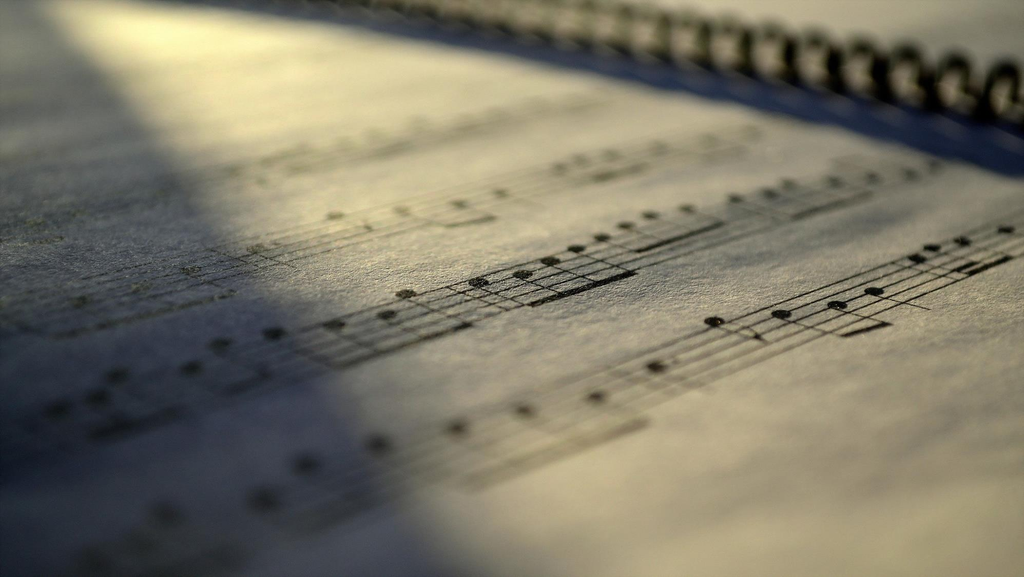
Discussions
Improvement:
Connections,
More techniques;
Complexity；
...

Slide 18
Q & A

